Slide 1
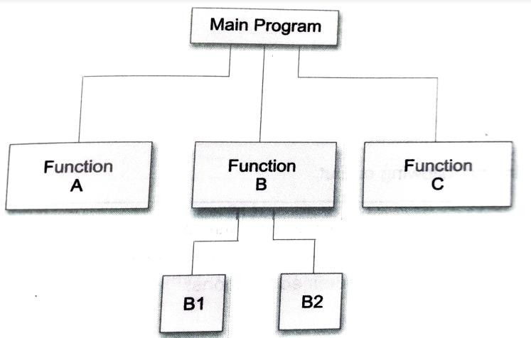
FUNCTIONS
3

Slide 2
FUNCTIONS
A function is a block of code that performs a specific task.
Dividing complex problem into small components makes program easy to understand and use.
The idea is to put some commonly or repeatedly done task together and make a function, so that instead of writing the same code again and again for different inputs, we can call the function.
Two types: Library and User-defined functions
3

Slide 3
About Functions
Every function has a unique name. This name is used to call function from “main()” or other function.
A function can be called from within another function
A function is independent and it can perform its task without intervention from or interfering with other parts of the program.
A function performs a specific task.
A function returns a value to the calling program. This is optional and depends upon the task your function is going to accomplish.
It facilitates top-down modular programming
Length of the program is reduced through functions
Saves time and space
Easy to understand, test, debug and maintain
3

Slide 4
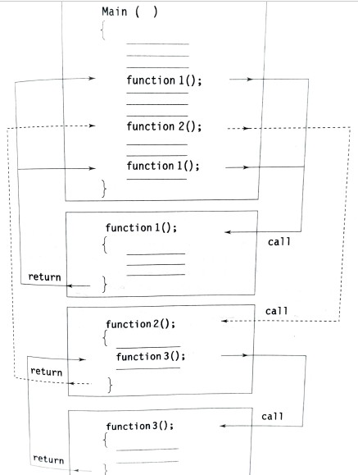
Flow of control in a multi-function program
3

Slide 5
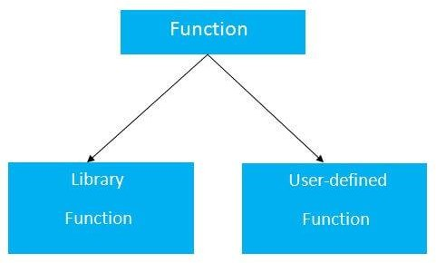
Function Types
3

Slide 6
User-defined Functions
Elements:
Function declaration
Function definition
Function call
3

Slide 7
User-defined Functions
Syntax for function declaration:
return_type function_Name(type1 parameter1, type2 parameter2,...);
Example: int multiply(int a, int b);
3

Slide 8
User-defined Functions
Syntax for function definition:
Return_type function_Name(type1 parameter1, type2 parameter2,...)
{
// function body
//local variable declaration
// executable statements
//return statement
}
// formal parameters
Example:
int multiply(int a, int b)
{
return (a*b);
}
8

Slide 9
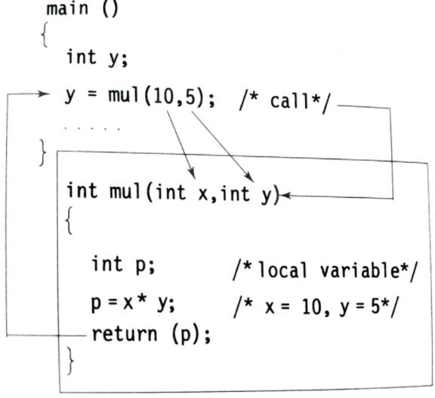
Function Call

Slide 10
Return Values
A function may or may not return send back any value to the calling function
It return one value per call
All functions by default return int types
Syntax:
return; // does not return anything return (expression);
Example:
return(p); return(x*y); return(2.5 * 3.0);
// return the value 7

Slide 11
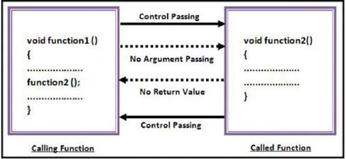
User Defined Function Categories
1. Functions with no arguments and no return values.

Slide 12
User Defined Function Categories
1. Functions with no arguments and no return values.
Example
#include <stdio.h> void sum();
int main()
{
sum(); return 0;
}
void sum()
{
int a,b;
printf("Enter the value of A and B: \n"); scanf("%d %d", &a, &b);
printf("The sum of A+B is %d", a+b); }

Slide 13
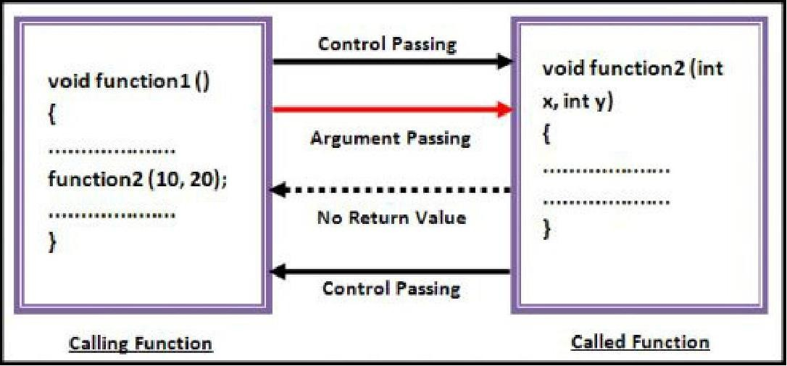
FUNCTION TYPES
2. Functions with arguments and no return values.

Slide 14
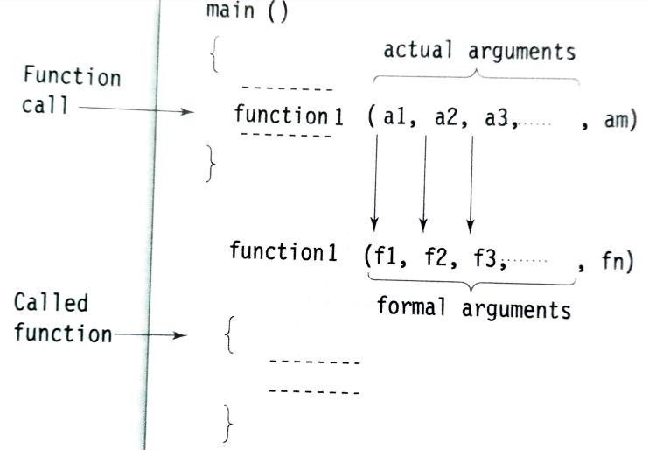
FUNCTION TYPES
2. Functions with arguments and no return values.
Fig. Arguments matching between function call and the called funct1io4 n

Slide 15
FUNCTION TYPES
2. Functions with arguments and no return values. Example:
#include <stdio.h>
void sum(); int main()
{
int a=20, b=30; sum(a,b); return 0;
}
void sum(int c, int d)
{
printf("The sum of A+B is %d", c+d);
}
15

Slide 16
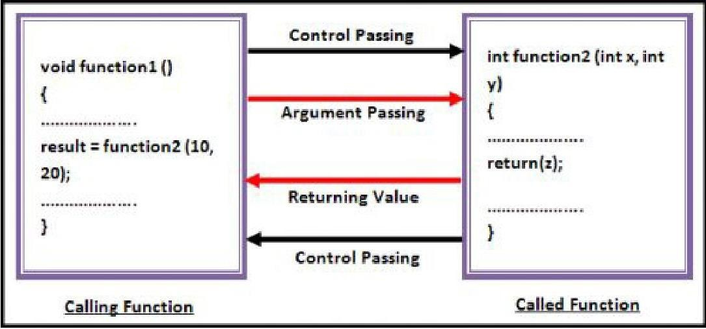
FUNCTION TYPES
3. Functions with arguments and return values.

Slide 17
FUNCTION TYPES
3. Functions with arguments and return values. Example:
#include <stdio.h>
int sum(int, int); int main()
{
int a=20, b=30,c; c=sum(a,b);
printf("The sum of A+B is %d", c); return 0;
}
int sum(int c, int d)
{
return(c+d); }

Slide 18
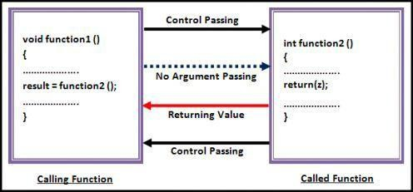
FUNCTION TYPES
4. Functions with no arguments and return values.

Slide 19
FUNCTION TYPES
4. Functions with no arguments and return values.
Example:
#include <stdio.h> int sum();
int main()
{
int c; c=sum();
printf("The sum of A+B is %d", c); return 0;
}
int sum()
{
int c=10; int d=20; return(c+d);
}
19

Slide 20
Function Examples
#include<stdio.h>
int multiply(int a, int b);
int main()
{
int i, j, result;
// Function declaration
printf("Please enter 2 numbers you want to multiply...");
scanf("%d%d", &i, &j);
result = multiply(i, j); // Function Call printf("The result of multiplication is: %d", result); return 0;
}
int multiply(int a, int b)
{
return (a*b);
}
// Function definition

Slide 21
Parameter Passing to functions
The parameters passed to function are called actual parameters.
The parameters received by function are called formal parameters.
Pass by Value: In this parameter passing method, values of actual parameters are copied to function’s formal parameters and the two types of parameters are stored in different memory locations. So any changes made inside functions are not reflected in actual parameters of caller.
Pass by Reference Both actual and formal parameters refer to same locations, so any changes made inside the function are actually reflected in actual parameters of caller.

Slide 22
Pass / Call by Value
void swap(int x, int y)
{
int tmp = x; x = y;
y = tmp;
printf("Swapped values (x,y) evaluate to: %d,%d\n",x,y);
}
Output
Before swapping (m,n) evaluate to: 6,10 Swapped values (x,y) evaluate to: 10,6 After swapping (m,n) evaluate to: 6,10
int main()
{
int m = 6; int n = 10;
printf("Before swapping (m,n) evaluate to: %d,%d\n",m,n); swap(m,n);
printf("After swapping m,n evaluate to: %d,%d\n",m,n);
}
22

Slide 23
Sample Program – find largest element of an array
#include<stdio.h> #define MAX 100
int findMaxElem(int []); int n;
int main()
{
int a[MAX], mxelem, i;
printf(“Input the no. of elements to be stored
in an array : “);
scanf(“%d”, &n);
printf(" Input %d elements in the array :\n", n); for(i=0;i<n;i++)
{
printf(“Element - %d : “,i);
scanf(“%d”, &a[i]);
}
mxelem=findMaxElem(a);
printf(“ The largest element in the array is : %d\n”,
mxelem);
return 0;
}
int findMaxElem(int a[])
{
int i=1, mxelem; mxelem=a[0]; while(i < n)
{
if(mxelem<a[i]) mxelem=a[i];
i++;
}
return mxelem; }
23

Slide 24
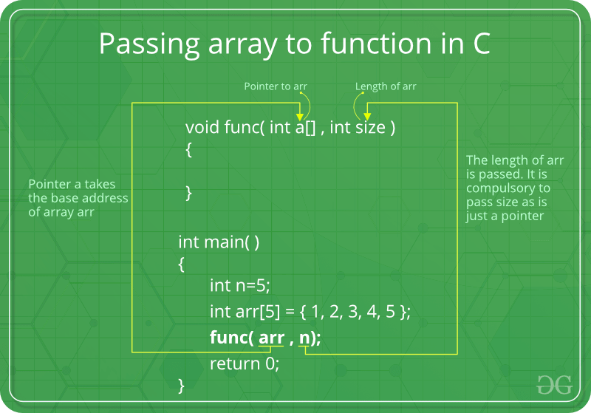
24

Slide 25
Pass / Call by Reference
void swap(int *x, int *y)
{
int temp;
temp = *x;
*x = *y;
*y = temp; return;
}
#include <stdio.h>
void swap(int *x, int *y); int main ()
{
int a = 100; int b = 200;
printf("Before swap, value of a : %d\n", a );
printf("Before swap, value of b : %d\n\n", b );
Output
swap(&a, &b);
Before swap, value of a : 100 Before swap, value of b : 200
printf("After swap, value of a : %d\n", a ); printf("After swap, value of b : %d\n", b ); return 0;
After swap, value of a : 200 After swap, value of b : 100
25
}

Slide 26
FUNCTIONS - Advantages
It provides modularity to your program's structure.
It makes your code reusable.
In case of large programs with thousands of code lines, debugging and editing becomes easier if you use functions.
It makes the program more readable and easy to understand.
It saves time and space

Slide 27
Recursion Functions
When some statement in a function calls the same function it is in, a recursion has occurred. Such a function is called recursive function.
Void fact()
{
fact();
}
Int main()
{
fact();
}

Slide 28
Recursion - Example
int rect(int x)
{
int f; if(x==1)
return 1;
else
f = x*rect(x-1); return f;
}
Output:
Enter a number: 4 Factorial value: 24
#include <stdio.h> int rect();
int main()
{
int a, fact;
printf("Enter a number: "); scanf(“%d”, &a);
fact = rect(a);
printf(“Factorial Value: %d”, fact); return 0;
}

